Slide 1
Introduction to Computer Programming Lecture 6.1:
Reading and Writing Files, User Input
Hemma Philamore
Department of Engineering Mathematics

Slide 2
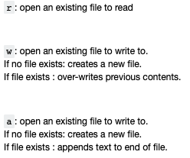
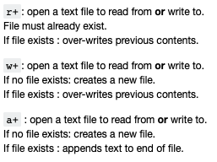
Reading/Writing files
Functions for reading and writing to external files:
open, read, write, close
Data structures can be populated based on data in another format (text file, database, etc.)
open(file_path, mode_specifier)

Slide 3
Why do we need to close a file?
Not automatically closed.
Risk of overwriting.
Saves changes to file.
Depending on OS, you may not be able to open a file simultaneously for reading and writing.
Example: If a program attempts to open a file that is already open (has not been closed), an error may be generated.

Slide 4

HighScore Table
The table should be saved to a file
1
John Mayer
550
2
Mary Loe
480
3
Tony Times
380
4
Kent Clear
305
5
Sara Knight
150

Slide 5
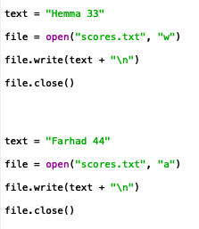

Writing Files
Mode specifier to write
Mode specifier to append
Open the file using a text editor to confirm it's contents.

Slide 6
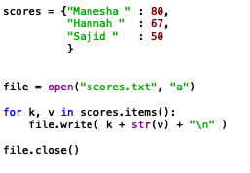
Writing Files
Dictionary
Open file before for loop
Close file after for loop
Use for loop to write dictionary to text file
Open the file using a text editor to confirm it's contents.

Slide 7
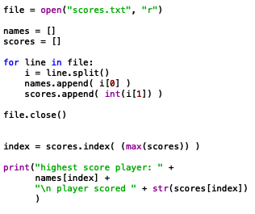
Reading Files
Open with mode specifier “r”
Open returns an iterable object.
Use for loop to iterate
Remember to close the file!

Slide 8
Reading Files
Split divides items separated by spaces into string items of list. Alternative delimiter can be selected
Finding the highest scoring player

Slide 9


Automatically close files using with
It can be difficult to remember to close the file
with open opens the file…
…it is closed again automatically when the code unindents
Notes:
Lots of errors in with opens : redo example

Slide 10
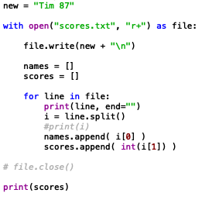
Read and write
Mode specifier allows read and write
write
read

Slide 11


open(file_path, mode_specifier)
open(“scores.txt”, w)
Documents
scores.txt
Folder_1
Folder_2
myScores.txt
scores.txt
6_1_read_write.py

Slide 12
open(file_path, mode_specifier)
open( “../Folder_1/myScores.txt”, w)
Documents
scores.txt
Folder_1
Folder_2
myScores.txt
scores.txt
6_1_read_write.py

Slide 13
open(file_path, mode_specifier)
open(“../scores.txt”, w)
Documents
scores.txt
Folder_1
Folder_2
myScores.txt
scores.txt
6_1_read_write.py

Slide 14

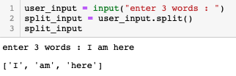
Input
Variable to store the user input
Prompt shown to the user
Delimited values returned as a list

